Slide 1


Detection and prevention of urban violence events in a distributed video surveillance system
Supervisors : Ahmed Azough, Dirss Yakoubi, Nicolas Travers, Leopold Fischer (Cisco)
Candidate : Steven Le Moal

Slide 2
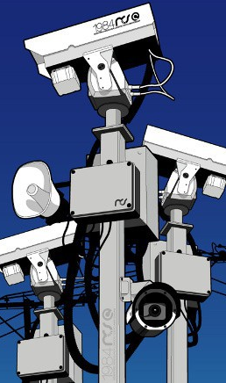
Context
Violence is one of the leading causes of mortality worldwide among persons between the age of 15 and 44 (World Health Organization)
Large number of camera and developpement of the clood
Occlusion, poor image resolution, visual noise, fast changes in events and/or in interactions, data encoding, illumination changes, and other factors make the process difficult. A methodology and good practice for distributed video surveillance must be generalized
To assist security staff and ensure safety, automated surveillance systems that recognize specific pattern such as abnormalities in real time are critical.

Slide 3
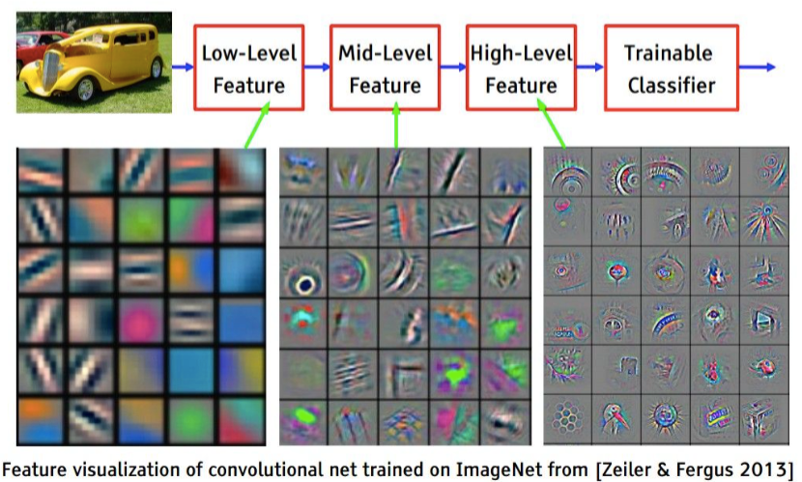
Context
Only low-level features extraction (color, texture and shape) is reliable
Links between high-level concepts and low-level features are difficult to establish
Limitations of machine learning approaches on long events and multicamera videos.

Slide 4
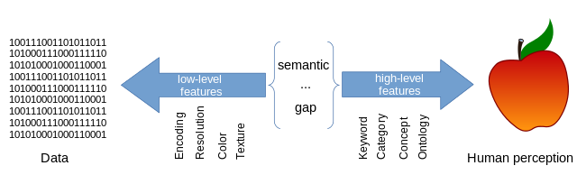
Context
The semantic gap
The discrepancy between, on one hand the limited descriptive power of current automatic video analysis generating effectively only low-level features, and on the other side the richness of user semantics and interpretations.

Slide 5
Problematics
How can we learn and construct the relationship between high-level semantic representation of events and low-level (and mid-level) detections?
How can we link different scene semantic representation into a real-world description (meaningful interpretation)?
How can we minimize the training time and the hardware requirement for an automatic distributed surveillance?
Notes:
Distributed
link high - low
Realtime - minimise

Slide 6
Objectives
Extraction of objects and meaningful events (firstly violence than other human activity) from a video sequence using existing methods to create a semantic scene representation in a graph (with the PhD student : LEFEBVRE Pierre)
Experiment with urban violence prediction (and tracking) for distributed video surveillance system (multiple views).
Describe the result and propose a viable solution

Slide 7
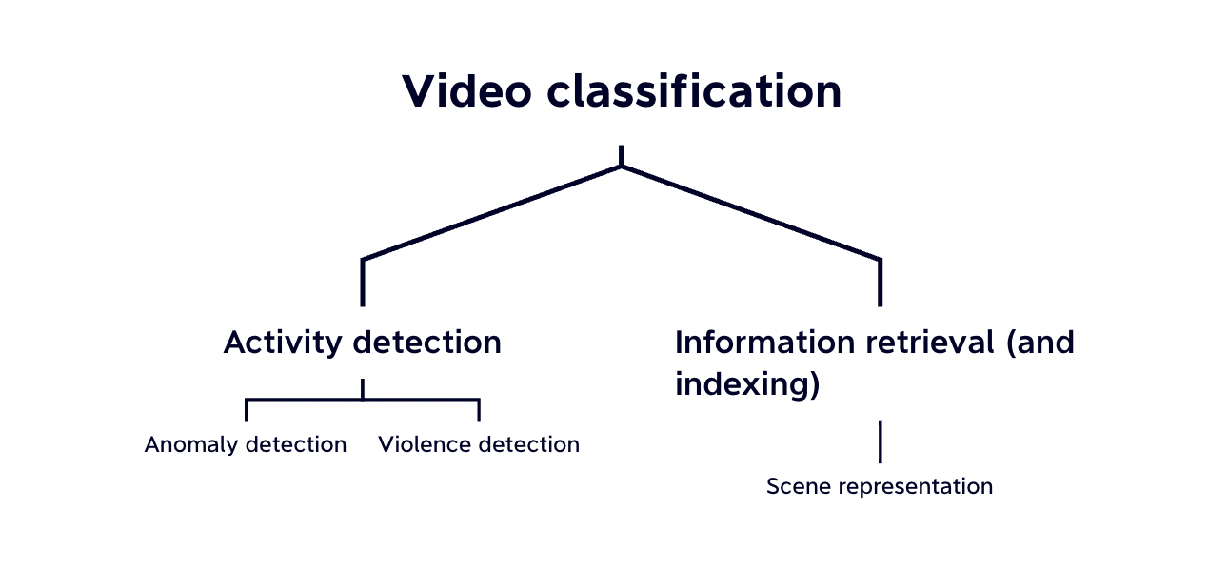
State of the art
Notes:
For end to end model, they can be apply in both violence and anomaly detection

Slide 8
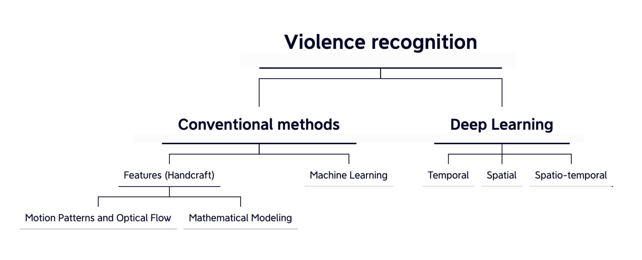
State of the art

Slide 9
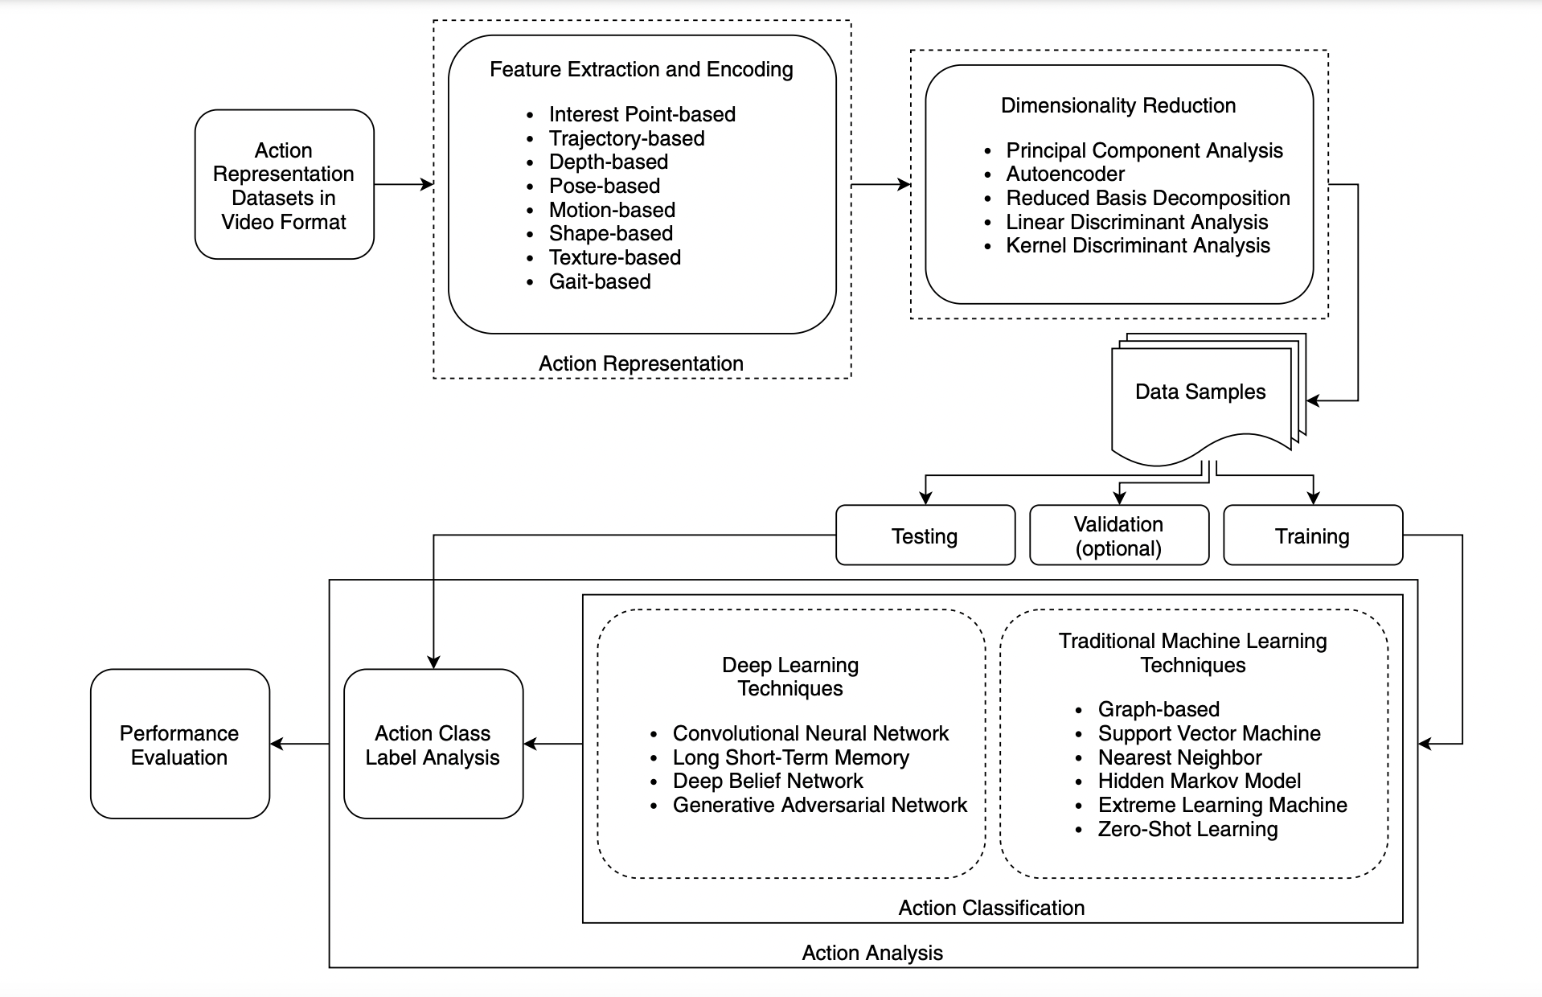
General pipeline

Slide 10
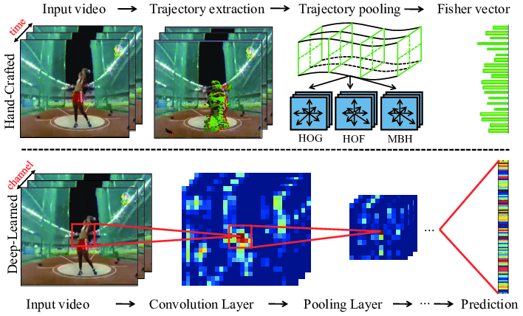
State of the art – Features extractions

Slide 11
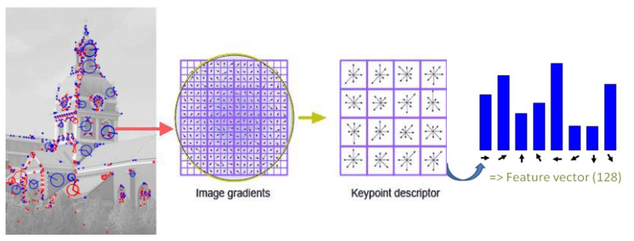
State of the art – Features extractions
Handcrafted features
They give detail on a ‘specific’ independent aspect of an image : motion blobs, motion vector, speed direction and density, acceleration and movement (with direction), spatio-temporal and motion streams, optical flow and motion region.
Key points detection is largely used, because it finds the points in an image distinct of its surroundings, and ideally it considers two segments : robustness and computational speed.
Notes:
State-of-the-art feature extraction techniques include SIFT, SURF, MoSIFT, HOG, HOF (varient/ extension include STIP, Violence flow descriptor, Motion boundary histograms, MoBSIFT and many other) with the use of BoW.
Problem : give bad results with bad illumination, occlusion, or slit movement of the camera (some are computationaly costly) .

Slide 12
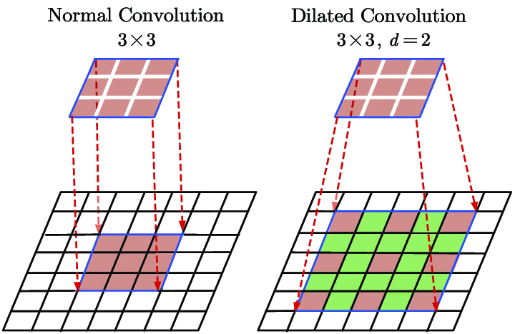
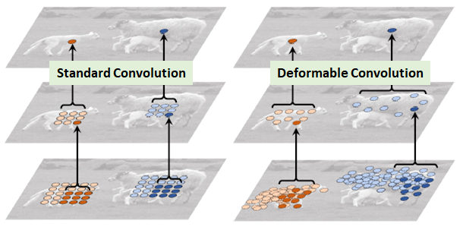
State of the art – Features extractions
Deep Learning
CNN (or ConvNet), which consist in most cases of three layers (convolutional layers, pooling layers, and fully connected layers), are the most popular subfield owing to a wide range of data representation because they are very robust (depend on the dataset).
Convolutions extract deep feature information from frames : computing the correlation between the pixels, with the aspect of location also included.
Trainning neural networks (CNN in this case) using transfer learning (using the parameters of already trained model: Resnet, Mobilnet...) can be very helpful for deep learning training
Notes:
Different configuration of layers (ex : softmax layer, morphological analysis, encode/decode...) can be applied to get the best convergence or get more in-depth information. Deformable or dilated convolutions can also be interesting given the additional information we can get, even though they are most costly to compute.

Slide 13
State of the art – Learning
Machine Learning
The early VD methods were largely considering of only image processing and pattern recognition methods to predict violence (or abnormal) events. Once features are extracted, they are fed into classifiers such as SVM, KNN, K-Means, Naıve Bayes, particle filters with an approximation inference scheme that computes the distributions of hidden Markov model, AdaBoost...
Machine learning is mostly limited to situations with instant normal motion, not complex real-world situations. Traditional image-based surveillance methods are designed to function for static data, where events occur in a sequence of images.
Most of these methods do not result in trustyworthy decisions due to their spatial image processing.
Notes:
In supervised learning-based approaches (for ML), the most popular approach used by researchers is the support vector machine (SVM) approach.

Slide 14
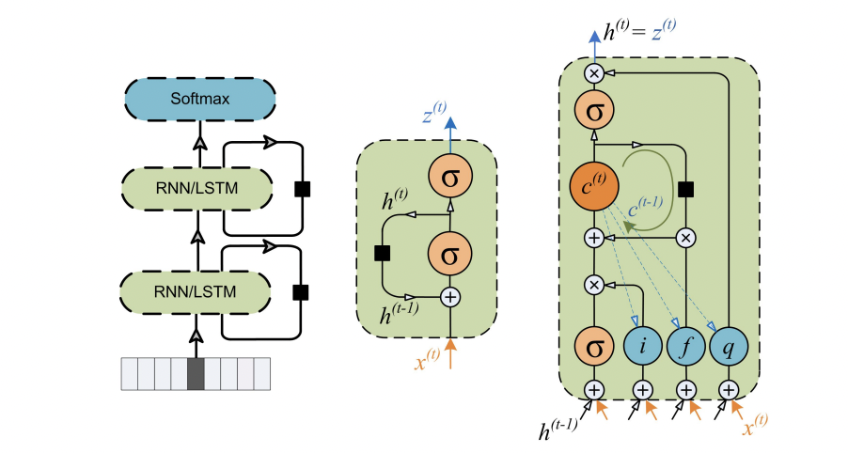
State of the art – Learning
Deep Learning
By nature, a pattern emerges in a sequence of frames, hence, working with spatial data is not always successful for an activity recognition task. Deep sequence learning models are the most popular research topic.
RNNs are used to comprehend these sequences. One of the problem is the lost of long-term sequential information, also known as vanishing gradient, and it may be solved using a certain sort of RNN using LSTM
Notes:
Early research used basic CNNs, but modern methods use different types of temporal and spatio-temporal approaches. Spatial deep models use features to classify the events (activities). Spatial deep learning approaches are uncommon.
Using multilayer LSTM network : we see an improvement in performance when adding additional network layers.

Slide 15
State of the art – Discussion
Zhandos Zhumanov Aidana Gumar Batyrkhan Omarov, Sergazi Narynov and Mariyam Khassanova.
State-of-the-art violence detection techniques in video surveillance security systems: a systematic review.
PeerJ Computer Science, 2022.
Amin Ullah Khan Muhammad Mohammad Hijji Sung Wook Baik Fath U Min Ullah, Mohammad S. Obaidat.
A comprehensive review on vision-based violence detection in surveillance videos.
ACM Compt. Surv., 2022.
Shabana Habib Syed Muhammad Mohsin Prayag Tiwari Shahab S. Band Neeraj Kumar Nadia Mumtaz, Naveed Ejaz.
An overview of violence detection techniques: Current challenges and future directions.
arXiv, 2022.
Notes:
We could also add RLVS

Slide 16
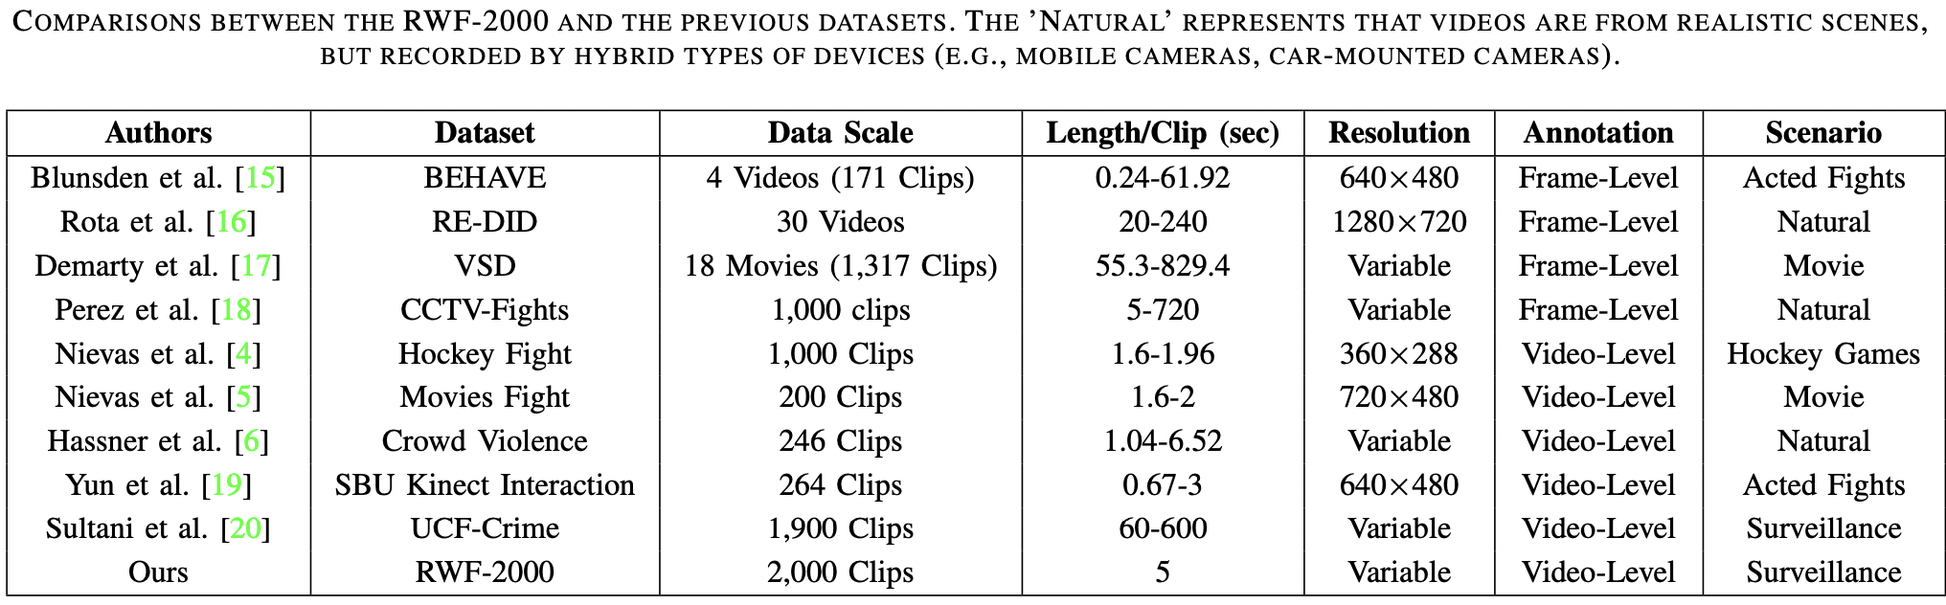
State of the art – Discussion
Cheng, M., Cai, K., Li, M.: Rwf-2000: An open large scale video database for violence detection. In: 2020 25th International Conference on Pattern Recognition (ICPR), pp. 4183–4190. IEEE (2021)
Notes:
We could also add RLVS

Slide 17
Experimental method
Dataset (using bach tranning) : RWF2000, XD violence, violent flow, RLVS .... (UCF Crime : multiple class dataset)
Hardware (Testing specifics only) : try realtime with different cisco camera on the clood
Hardware (Training – Basic testing) will also be mentionned later on
Model : Deep Learning (Spatial, Temporal, Hybrid) , also using Transfer Learning (Resnet, MobileNet, VG...) , and also Attention layer.
Multi-stream input (with different combinaison)
Metrics : Accurcy, Precision, Recall, F1-score, AUC ROC, False alarm, Mising alarm, runtime (inference time), number of parameters (and complexity : GFLOPS)..
Parameters : bach size (depending on the dataset size), learning rate : 0.1, 0.001, 1 x 10⁻⁵

Slide 18
State of the art – Discussion
Problem
Dataset : because this is a ‘new’ (rising interest) topic, there are too few publically accessible datasets for video violence detection (Furthermore, we can also talk about the data imbalance, illumination variation or motion blur in some dataset). Violence detection is in need of appropriate standards for dataset.
Performance metrics : the most used are accuracy, precision, recall, F1-score, AUC-ROC, false alarm and missing alarm. Other metrics should also be incorporate, which are not enough used, computational and time-consuming cost, to have a more realistic discussion of performance result.
The most challenging work that need to be is to continue to explore new approaches for better performances and reduce the cost and computational resources : processing time, number of parameters,and model size.
Promising approaches are Federated Learning (for a distributed system especially), Reinforcement Learning and Vision Transformer.

Slide 19
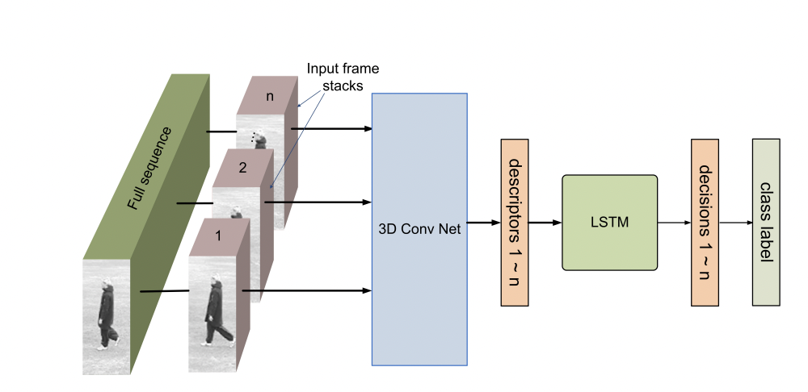
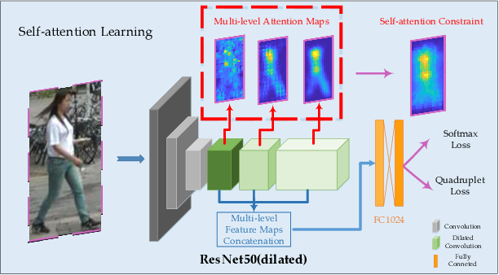
State of the art – Discussion
The best models use multi layers of CNN and LSTM (some also use Attention layer, the position of this layer can also give various result)
3D CNN + RNN (LSTM)
Features : Attention CNN
Notes:
Self Attention help the model focus on the most important aspect through backpropagation, we can also use mutli attention layers between the convolution layers)
Skeleton estimation for action recognition

Slide 20
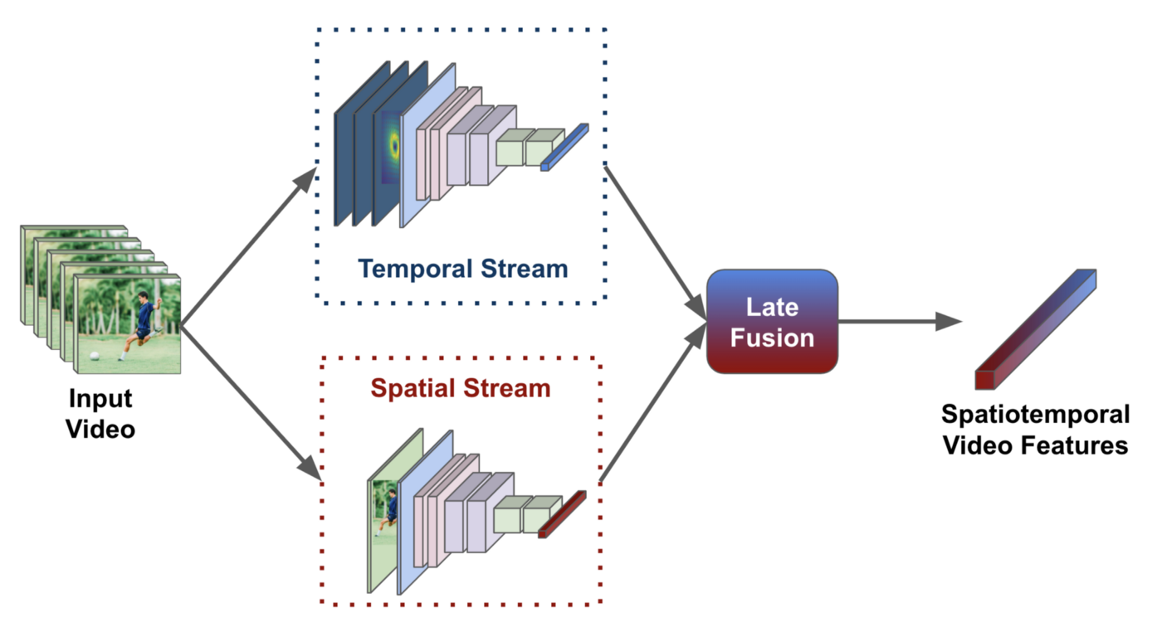
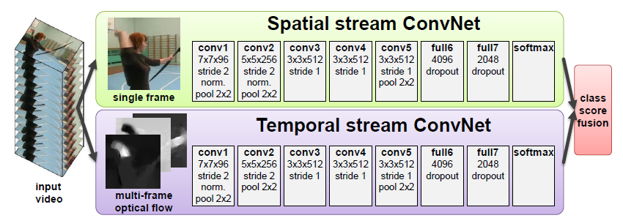
State of the art – Discussion
The best models combine different inputs (Multi-stream) : for example, one stream takes in background suppressed frames as inputs and other stream processes difference of adjacent frames, or the optical flow.

Slide 21
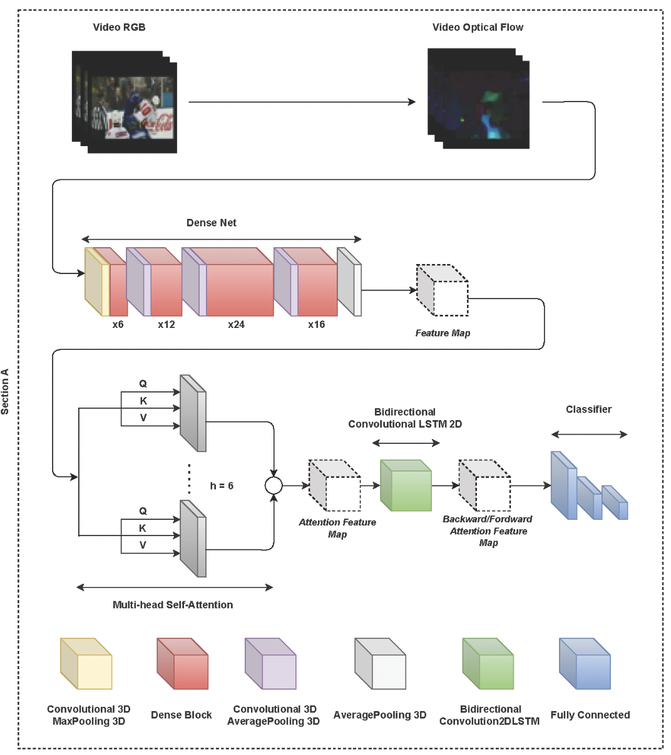
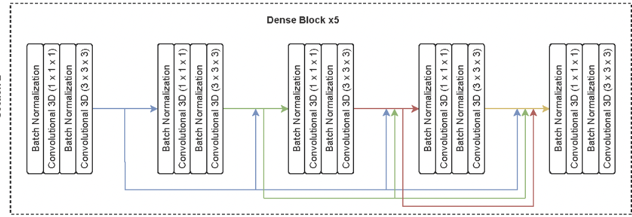
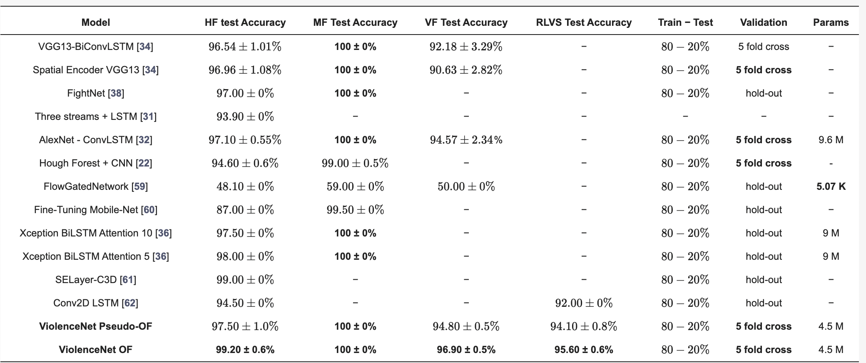
State of the art – Discussion
Fernando J. Rendón-Segador , Juan A. Álvarez-García , Fernando Enríquez and Oscar Deniz ViolenceNet: Dense Multi-Head Self-Attention with Bidirectional Convolutional LSTM for Detecting Violence (2021)
Notes:
Used Attention layer that showed improvement but not good dataset

Slide 22
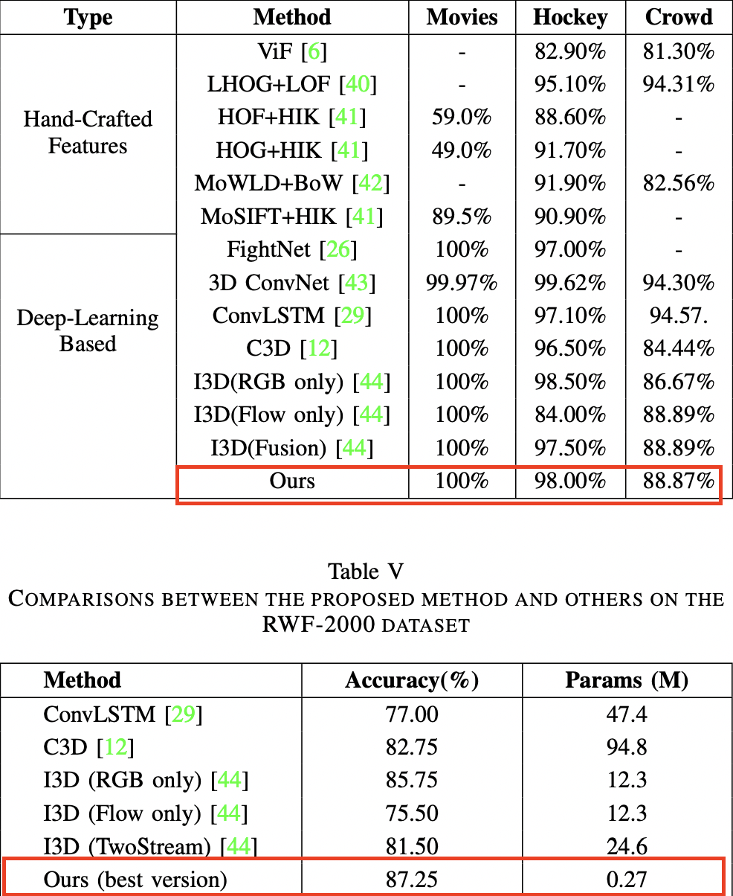
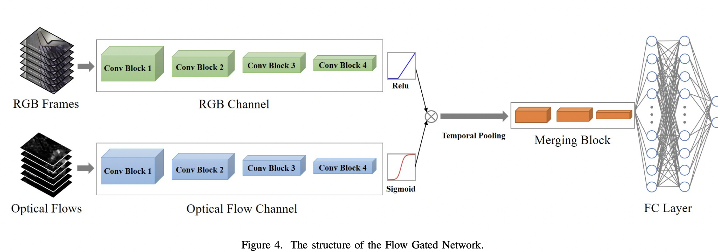
State of the art – Discussion
Cheng, M., Cai, K., Li, M.: Rwf-2000: An open large scale video database for violence detection. In: 2020 25th International Conference on Pattern Recognition (ICPR), pp. 4183–4190. IEEE (2021)
Notes:
present a new method that utilizes both the merits of 3D-CNNs and optical flow, namely Flow Gated Network.
They achieved reduced parameters by employing the concept of depth-wise separable convolutions from Pseudo-3D Residual Networks [59] and MobileNet [33] to adopt the 3D convolutional layers in their proposed model, which tremendously reduced their model parameters without compromising on the performance loss.
Two-Stream Inflated 3D ConvNets : Quo Vadis, Action Recognition? A New Model and the Kinetics Dataset
based on 2D ConvNet inflation: filters and pooling kernels of very deep image classification ConvNets are expanded into 3D, making it possible to learn seamless spatio-temporal feature extractors from video while leveraging successful ImageNet architecture designs and even their parameters.

Slide 23
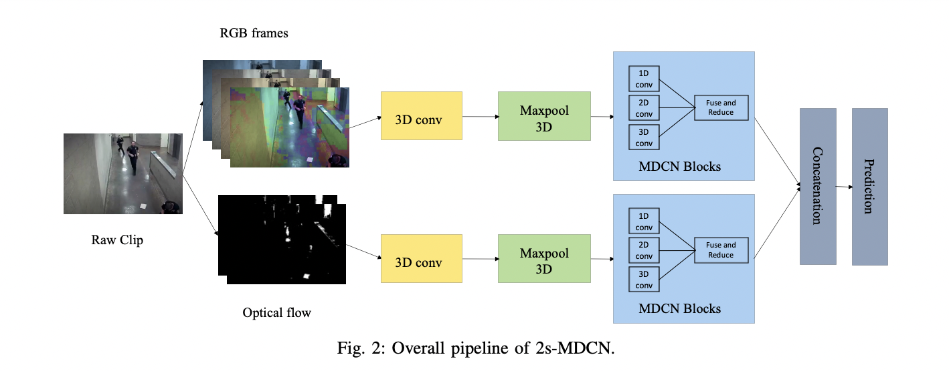
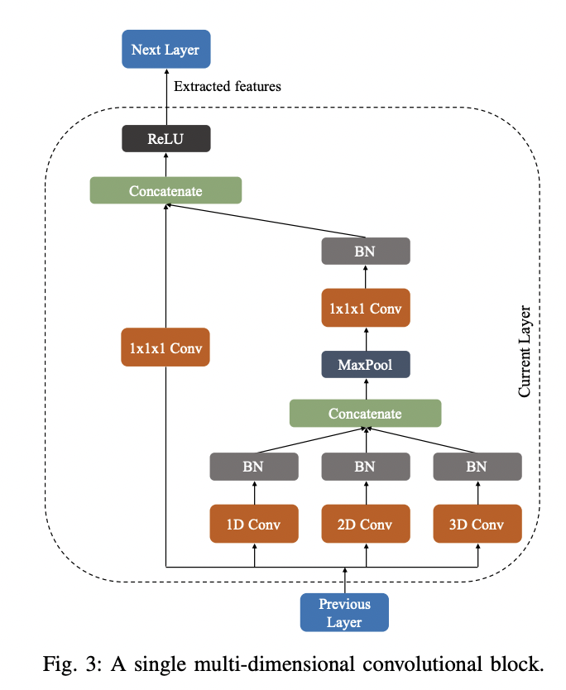
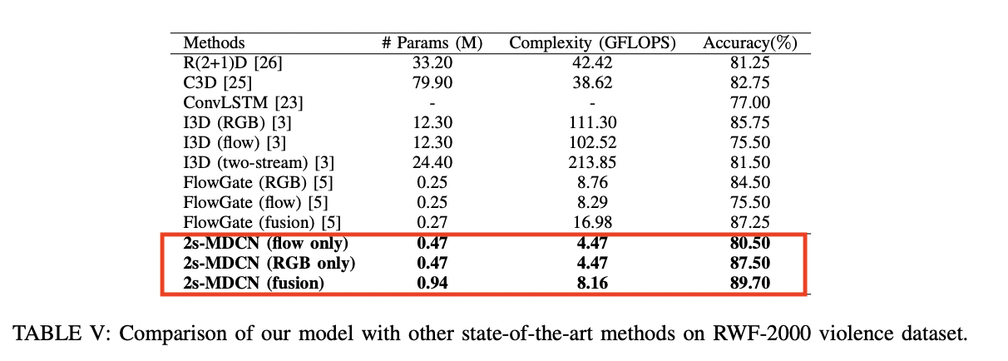
State of the art – Discussion
Dipon Kumar Ghosh and Amitabha Chakrabarty, Two-stream Multi-dimensional Convolutional Network for Real-time Violence Detection (2022)
Notes:
Even on other dataset
1D convolutional layer: The first module is 1D convolutional layer which extracts temporal features from the input. The kernel size of this convolutional layer is kt × 1 × 1. So that it performs convolution operation on a particular pixel over kt frames and extracts only temporal information of the corresponding pixel.
2D convolutional layer: The second module is 2D convolutional layer which extracts temporal features from the input. The kernel size of this convolutional layer is 1 × ks × ks. So that it performs convolution operation on a single frame and extracts only spatial information from the particular frame.
3D convolutional layer: The second module is 3D convolutional layer which extracts both spatial and temporal features from the input. The kernel size of this convolutional layer is kt × ks × ks. So that it performs convolution operation over kt frames and extracts temporal and spatial frames together. Each of these three modules is followed by a batch normalization layer. In our model, we used 3 the value of kt and ks. They extract information independently from the same spatioteporal position of the input and fuse together. In this process, our model can extract all the information from the input which reduces information loss and improves accuracy. Then, the fused features are passed through a maxpooling layer and a 1 × 1 × 1 convolution layer which reduces the number of channels for the next layer. This reduction module keeps our model size small. Moreover, a concatenated skip connection [13], followed by a ReLU layer, is added to stabilize the model which also helped to improve accuracy. Skip connection concatenates features from the previous layers to the current layer which allows more information to be obtained from the previous layers and reduces loss of information. Concatenated skip connections also help the gradient to propagate better and fix the vanishing gradient problem. To match the input channel to the output channel, we have used a convolutional layer of kernel size 1 × 1 × 1 and stride of size 1 × 2 × 2.

Slide 24
State of the art – Discussion
To note:
To reduce optical flow cost (for low hardware) :
FlowNet, LiteFlowNet (light-weight version of FlowNet),PWC-Net, LiteFlownet2 (lightweight version of FlowNet2), DenseFlow, NanoFlowNet.... Or use frame-difference video stream, i.e., the difference in the adjacent frames
2. To reduce trainning cost and parameters:
N. Honarjoo, A. Abdari and A. Mansouri, "Violence detection using pre-trained models," 2021 5th International Conference on Pattern Recognition and Image Analysis (IPRIA), Kashan, Iran, 2021, pp. 1-4,
Lightweight model using Pre-trained model such as Resnet50, VG16 or VG19 traind on with NN (= FC) only can give > 90% with lower computionnal cost
Or
..
Notes:
FlowNet: This is a deep neural network-based method for optical flow estimation that has shown good results on low-hardware platforms
DenseFlow: This is a Dense Optical Flow algorithm that is designed to run on low-power devices and embedded systems.

Slide 25
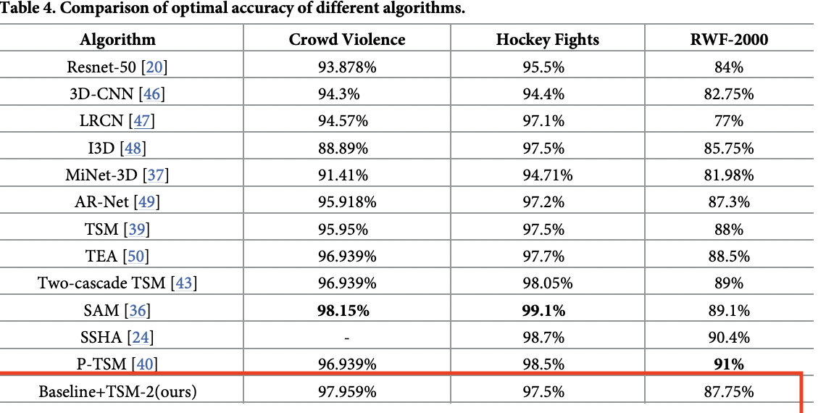
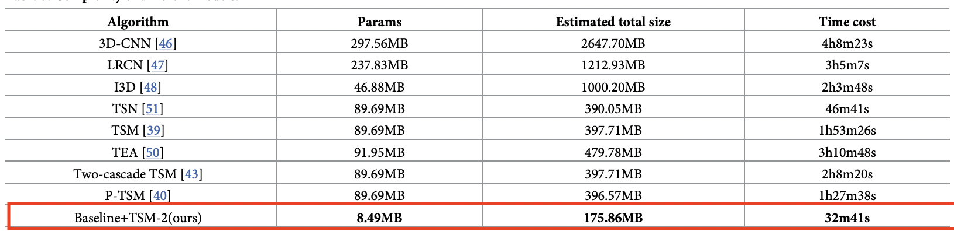
State of the art – Discussion
To note:
Youshan ZhangI , Yong Li, Shaozhe Guo,
Lightweight mobile network for real-time violence recognition (2022)
Notes:
we propose MobileNetTSM, a lightweight network, which uses MobileNet-V2 as main structure. By incorporating temporal shift modules (TSM), which can exchange information between frames, the capability of extracting dynamic characteristics between consecutive frames is strengthened.
Temporal shift module (TSM) was proposed by Lin [39] in 2019, which is specially designed to exchange some position information between adjacent frames by shifting some channels in the time dimension before the convolution layer extracts the characteristic information. After that, 2D convolution kernel can extract spatial and temporal information at the same time, which can achieve the performance of 3D convolution neural network with the complexity of 2D convolution neural network
TEA : Temporal Excitation and Aggregation for Action Recognition Yan Li, Bin Ji, Xintian Shi, Jianguo Zhang, Bin Kang, Limin Wang.
TSN : Temporal Segment Networks for Action Recognition in Videos Limin Wang, Yuanjun Xiong, Zhe Wang, Yu Qiao, Dahua Lin, Xiaoou Tang, and Luc Van Gool
TSM : Lin J, Gan C, Han S.: Temporal shift module for efficient video understanding. In: Proceedings of the IEEE/CVF International Conference on Computer Vision; 2019. p. 7083–7093.

Slide 26
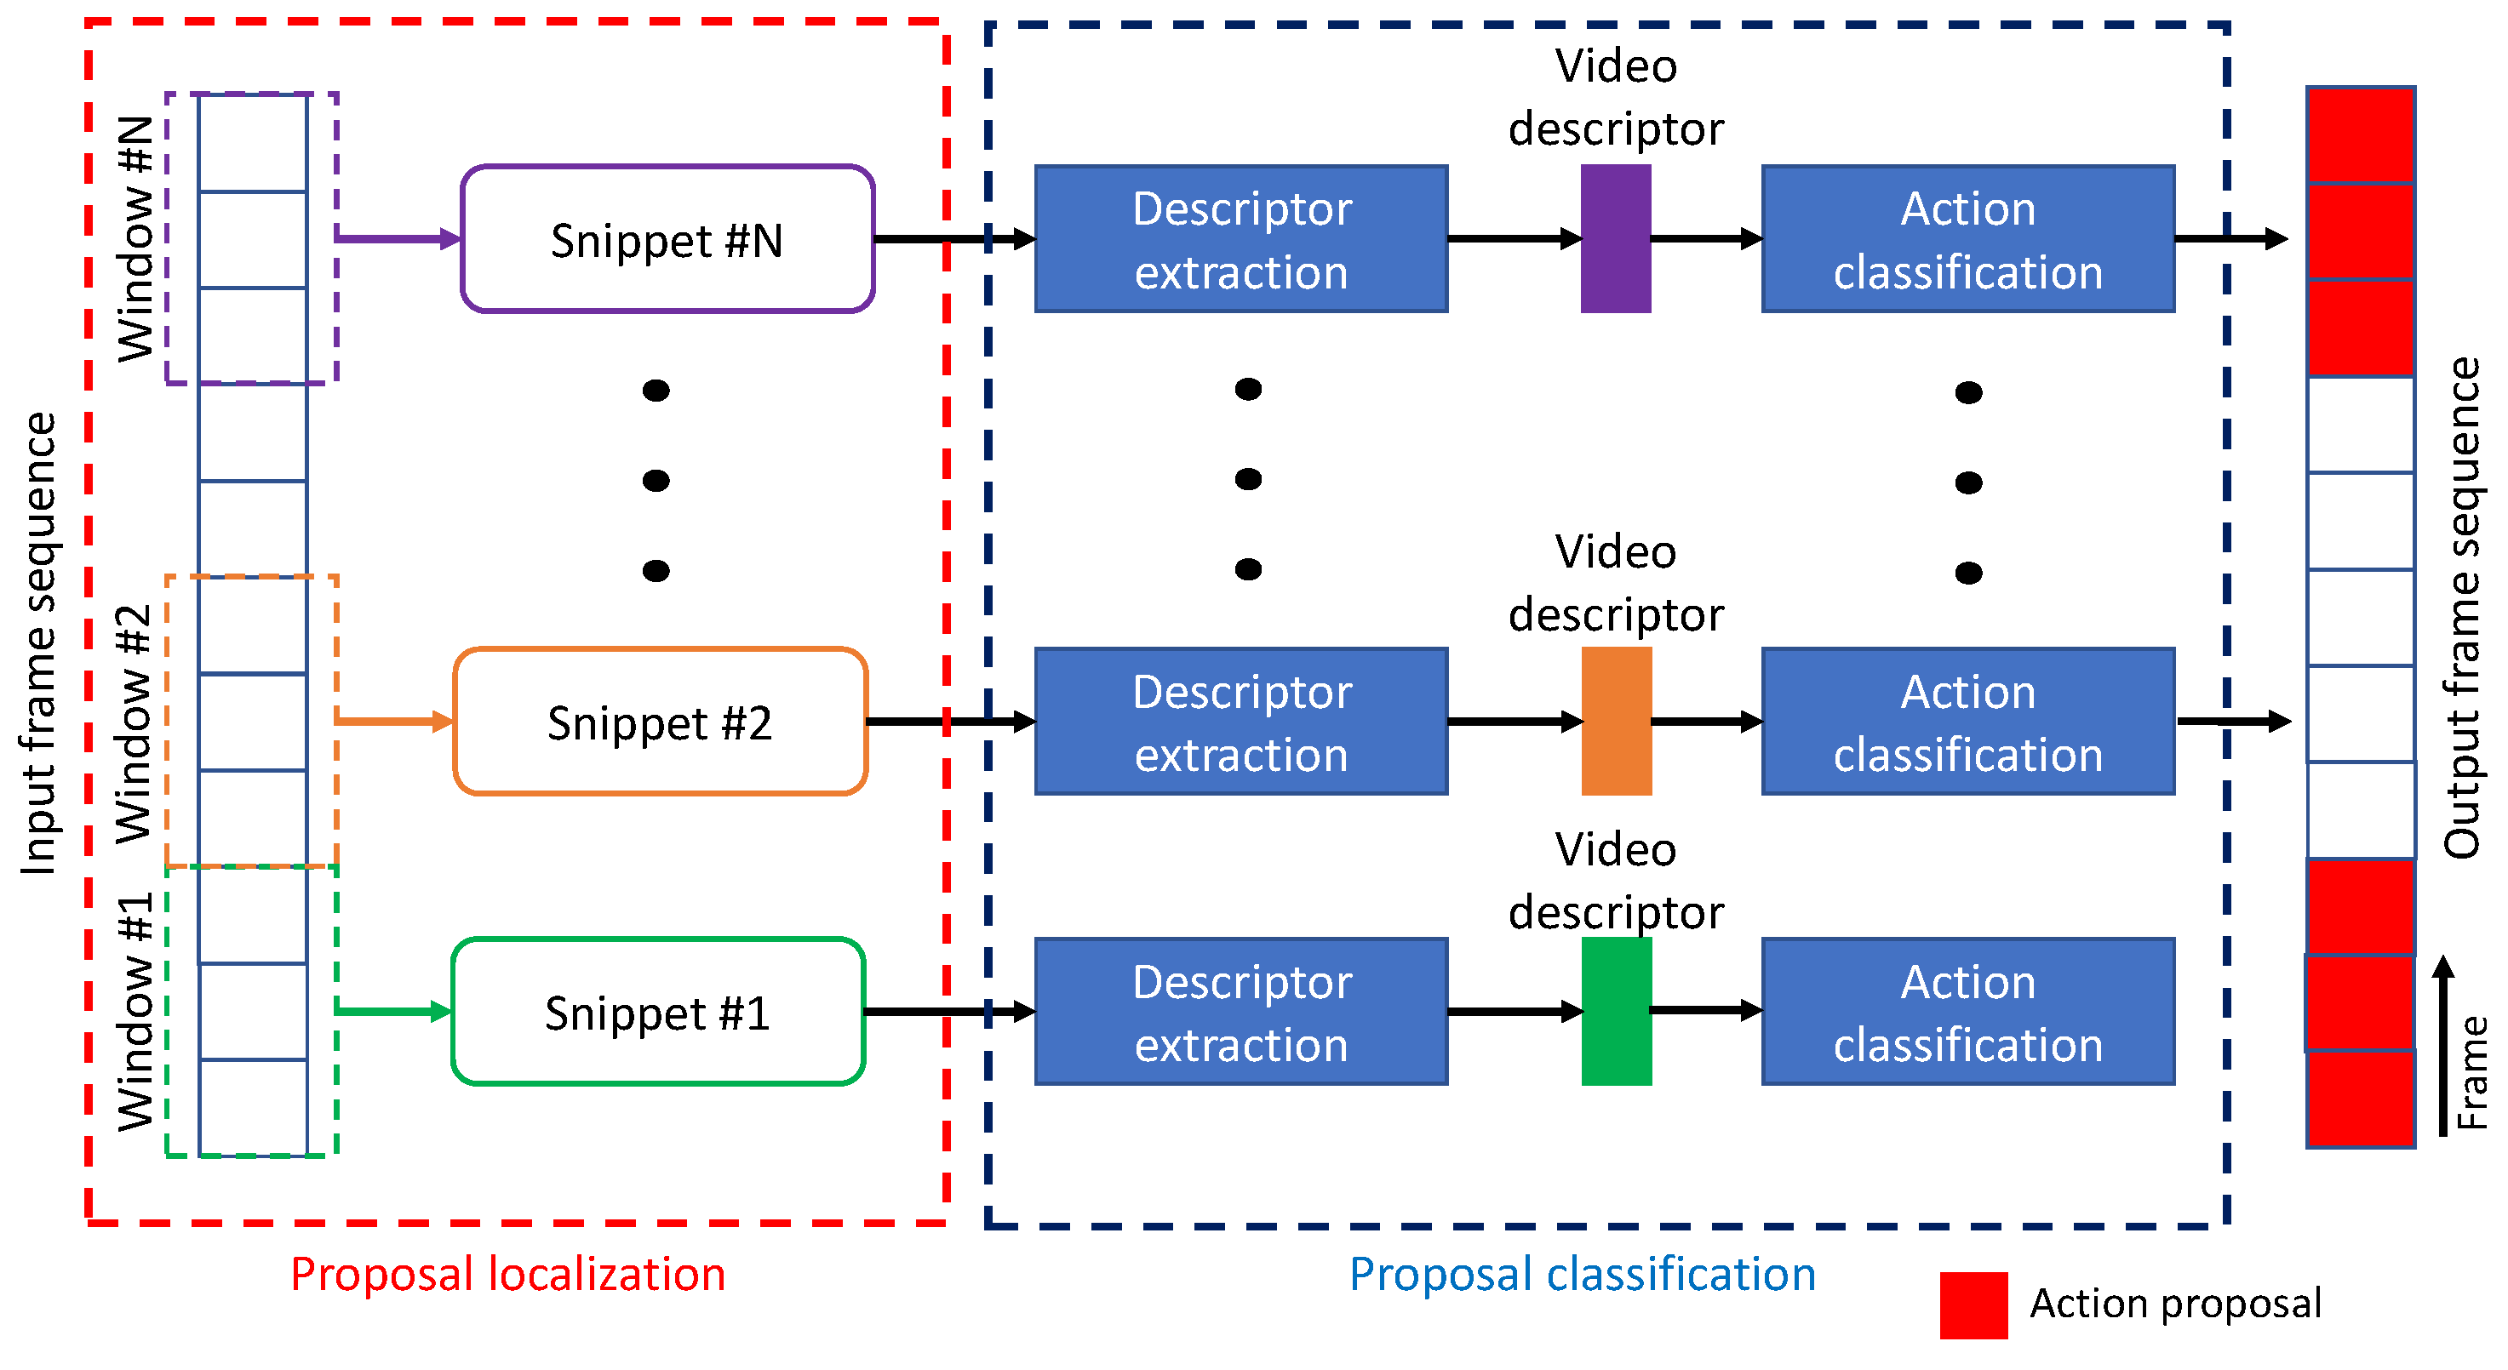
Action anticipation/Early action prediction
Sooksatra, S.; Watcharapinchai, S. A Comprehensive Review on Temporal-Action Proposal Generation. J. Imaging 2022, 8, 207
Use of similar sequence lerning model (LSTM, 3D CNN...)
Prediciting action before it append : Ops: Predicting Unintentional Action in Video, Dave Epstein ,Boyuan Chen, Carl Vondrick (2020)
Predicting next frames : Comparing Correspondences: Video Prediction with Correspondence-wise Losses Daniel Geng, Max Hamilton, Andrew Owens. (2022)
Notes:
TSM, TSN, TEA... (temporal action prediction)...
Human Action Recognition and Prediction: A Survey Yu Kong · Yun Fu
he result from state-of-the-art research was further analyzed to show its limitations and challenges for action proposal generation. TAPG performance in average recall ranges from 60% up to 78% in two TAPG benchmarks. In addition, several future potential research directions in this field are suggested based on the current limitations of the related studies.
The availability of big data and recent advance in computer vision and machine learning enable the reasoning about the future. The key in this research is how to discover temporal correlations in large-scale data and how to model such correlations. Results shown in Table 19 demonstrate the predictability of actions that can be used as a prior and inspiring more powerful action prediction methods. There are still some unexplored opportunities in this research, such as interpretability of temporal extent, how to model long-term temporal correlations

Slide 27
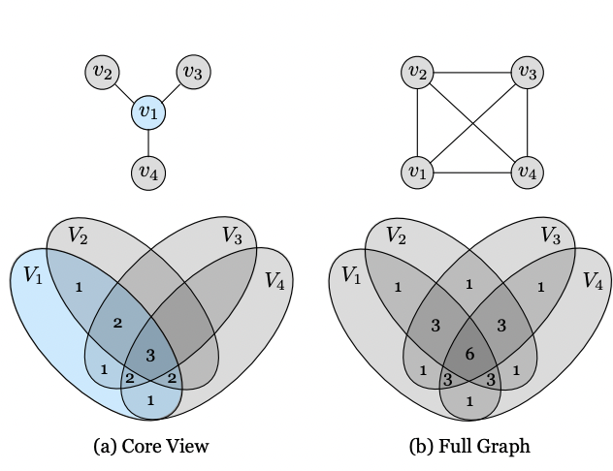
Multi-view
Multi-stream of different view then we fuse the feature matrix of all the view..
There are several ways to combine multiple streams of data in a multi-stream model. Some of the most common methods include:
Concatenation: This method concatenates the features learned by each stream along a specified axis, typically the last axis (channel axis) in the case of CNNs. This method is used in two-stream CNNs, where the features learned by the spatial stream and temporal stream are concatenated along the channel axis to form a single feature map.
Summation: This method adds up the features learned by each stream element-wise. This method is used in multi-modal CNNs, where the features learned by each modality are added up to form a single feature map.
Weighted Summation: This method is similar to summation but it allows to weight the contribution of each stream by a learned scalar value.
Gating: This method uses a gating mechanism to control the flow of information between streams. Gating mechanisms, such as the long-short term memory (LSTM) gate or the attention gate, learn to weight the contribution of each stream by using a learned scalar value for each stream.

Slide 28
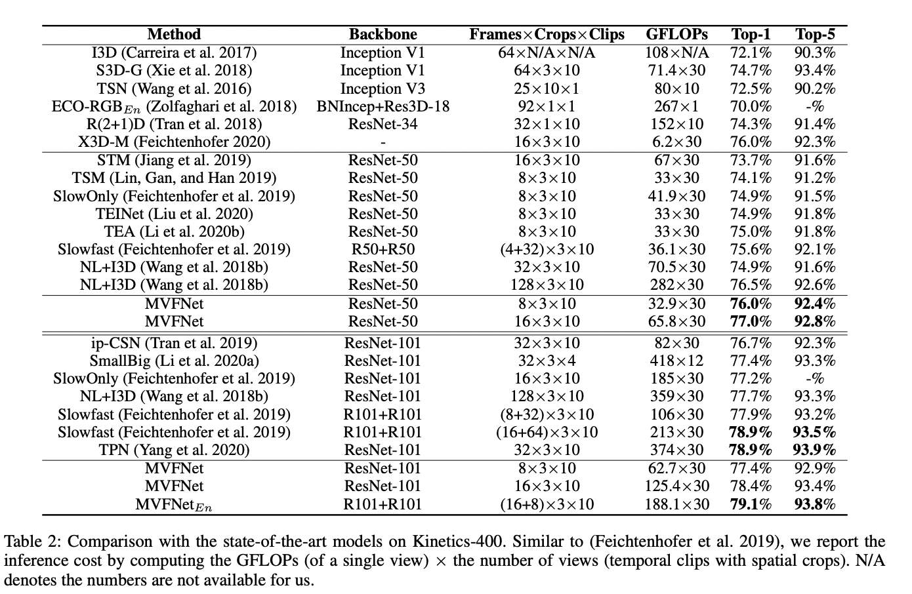
Multi-view
Deep Multi-view Learning Methods: A Review ,Xiaoqiang Yana , Shizhe Hua , Yiqiao Maoa , Yangdong Yea, Hui Yub
MVFNet: Multi-View Fusion Network for Efficient Video Recognition, 2021, Wu, Wenhao and He, Dongliang and Lin, Tianwei and Li, Fu and Gan, Chuang and Ding, Errui
Multi-view learning for visual violence recognition with maximum entropy discrimination and deep featuresLa, Shiliang Sun, Yuhan Liu, Liang MaoInformation Fusion 50, 43-53, 2019
Notes:
The input feature map channels are split into two parts, one for making part of the information in the original activation accessible, and the other for multi-view spatiotemporal modeling. In our module, multi-view modeling is performed via channel-wise convolution along the temporal, horizontal and vertical dimensions respectively, then the outputs of the three convolutions is element-wise added. Finally, the two part of features are concatenated together to combine the original activation and the multi-view modeling activation.
link.springer.com Deep multi-view representation learning for video anomaly detection using spatiotemporal autoencoders K Deepak, G Srivathsan, S Roshan, S Chandrakala Circuits, Systems, and Signal Processing 40 (3), 1333-1349, 2021 Visual perception is a transformative technology that can recognize patterns from environments through visual inputs. Automatic surveillance of human activities has gained significant importance in both public and private spaces. It is often difficult to understand the complex dynamics of events in real-time scenarios due to camera movements, cluttered backgrounds, and occlusion. Existing anomaly detection systems are not efficient because of high intra-class variations and inter-class similarities existing among activities. Hence, there is a demand to explore different kinds of information extracted from surveillance videos to improve overall performance. This can be achieved by learning features from multiple forms (views) of the given raw input data. We propose two novel methods based on the multi-view representation learning framework. The first approach is a hybrid multi-view representation learning that combines deep features extracted from 3D spatiotemporal autoencoder (3D-STAE) and robust handcrafted features based on spatiotemporal autocorrelation of gradients. The second approach is a deep multi-view representation learning that combines deep features extracted from two-stream STAEs to detect anomalies. Results on three standard benchmark datasets, namely Avenue, Live Videos, and BEHAVE, show that the proposed multi-view representations modeled with one-class SVM perform significantly better than most of the recent state-of-the-art methods. Conflux LSTMs network: A novel approach for multi-view action recognition Amin Ullah, Khan Muhammad, Tanveer Hussain, Sung Wook Baik Neurocomputing 435, 321-329, 2021 Multi-view action recognition (MVAR) is an optimal technique to acquire numerous clues from different views data for effective action recognition, however, it is not well explored yet. There exist several challenges to MVAR domain such as divergence in viewpoints, invisible regions, and different scales of appearance in each view require better solutions for real world applications. In this paper, we present a conflux long short-term memory (LSTMs) network to recognize actions from multi-view cameras. The proposed framework has four major steps; 1) frame level feature extraction, 2) its propagation through conflux LSTMs network for view self-reliant patterns learning, 3) view inter-reliant patterns learning and correlation computation, and 4) action classification. First, we extract deep features from a sequence of frames using a pre-trained VGG19 CNN model for each view. Second, we forward the extracted features to conflux LSTMs network to learn the view self-reliant patterns. In the next step, we compute the inter-view correlations using the pairwise dot product from output of the LSTMs network corresponding to different views to learn the view inter-reliant patterns. In the final step, we use flatten layers followed by SoftMax classifier for action recognition. Experimental results over benchmark datasets compared to state-of-the-art report an increase of 3% and 2% on northwestern-UCLA and MCAD datasets, respectively.
Self-supervised Learning:Generative orContrastive, Xiao Liu, Fanjin Zhang, Zhenyu Hou, Li Mian, Zhaoyu Wang, Jing Zhang, Jie Tang(2021)
TCLR: Temporal Contrastive Learning for Video Representation Ishan Dave, Rohit Gupta, Mamshad Nayeem Rizve, Mubarak Shah Center for Research in Computer Vision, University of Central Florida, Orlando, USA (https://arxiv.org/pdf/2101.07974.pdf) other(Contrastive Multiview Coding : https://arxiv.org/pdf/1906.05849.pdf)
Adversarial correlated autoencoder for unsupervised multi-view representation learning Xu Wang, Dezhong Peng , Peng Hu, Yongsheng Sang (https://sci-hub.ru/10.1016/j.knosys.2019.01.017)

Slide 29
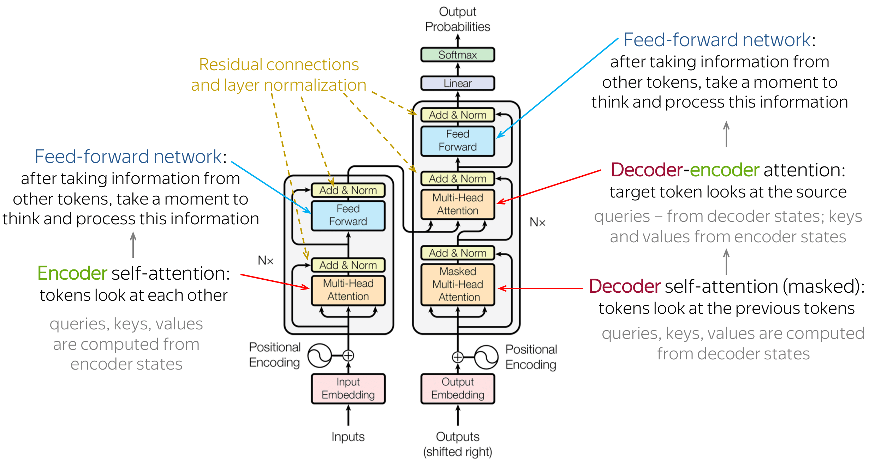
Transformer
Use Transformer for self-attention :
transformers are more robust than CNNs to changes in texture and generates different patterns of adversarial patches (learn more information on the location between features).
recent study shows that self-Attention may not be essential in Transformer., so we can imagine a two parts in the encoder block, one to handle global information and the other to propagate it locally
weakness of Vision Transformer is that it requires a lot of memory and a lot of data to train, but it is rapidly improving

Slide 30
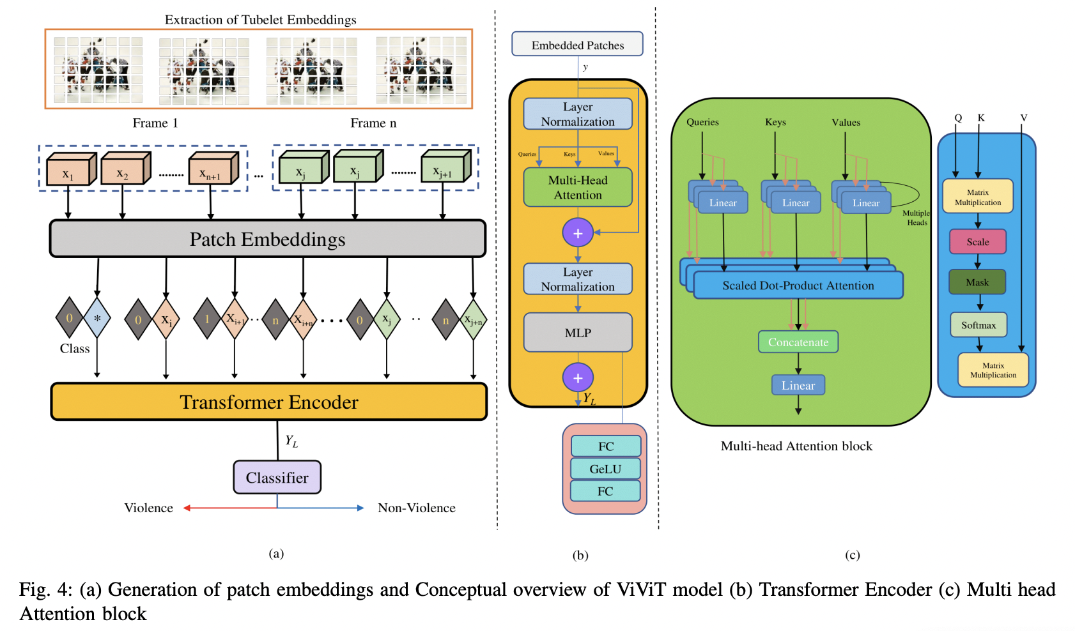
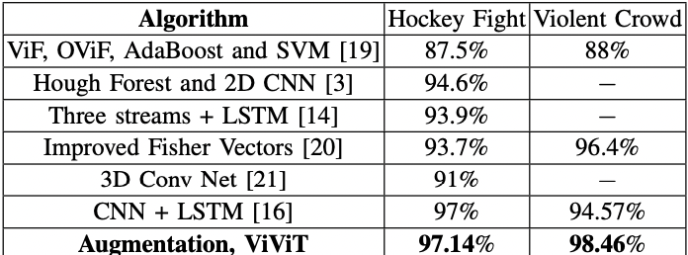
Transformer
Vision Transformers for Action Recognition: A Survey, Anwaar Ulhaq, Naveed Akhtar, Ganna Pogrebna, Ajmal Mian (2022)
L. Zhou, "End-to-End Video Violence Detection with Transformer," 2022 5th International Conference on Pattern Recognition and Artificial Intelligence (PRAI), Chengdu, China, 2022, pp. 880-884
The potential downsides of the recommended architecture is that while the proposed model showed promising violent detection performance, it necessitates a large quantity of data with annotated scene conditions in order for the model to be trained better. So, generative adversarial networks (also known as GAN) can be introduced on the video frames to enlarge the training data. Furthermore, applying of different variants of the transformer model can also be considered for enhancing the performance of the model.
Notes:
In the forefront of violence detection, the present novel end-to-end framework has incorporated video vision transformers (ViViT) for efficient violent state estimation in video clips. Firstly, the video clips are casted into several frames and then, various image augmentation techniques are applied on the processed frames. The retrieved frames are passed on through a ViViT architecture which learns specific patterns from spatio-temporal information of the clips using the transformer encoder.
L. Zhou, "End-to-End Video Violence Detection with Transformer," 2022 5th International Conference on Pattern Recognition and Artificial Intelligence (PRAI), Chengdu, China, 2022, pp. 880-884, doi: 10.1109/PRAI55851.2022.9904115.
Human action recognition is a widely investigated field in computer vision. Violence automatic detection is a subset of action recognition, which deserves special attention because of its wide applicability in unmanned security monitoring systems. This paper presents an end-to-end model, which introduces Transformer for human pose estimation and 3d convolutional neural network to capture motion present in spatial-temporal dimension. We train a 3d convolutional neural network to learn spatial-temporal features of human keypoint sequences which are the outputs of Transformer block. Our proposed model achieves an accuracy of 89% on the test set of large-scale video database RWF-2000, and obtains an accuracy of 93% on our own school violent video database. Our experiment result shows that transformer-based approach can be used in video violence detection.
Two-Stage Spatio- Temporal Vision Transformer for the Detection of Violent Scenes
Survey : Vision Transformers for Action Recognition: A Survey Anwaar Ulhaq, Naveed Akhtar, Ganna Pogrebna, Ajmal Mian
BEVT: BERT Pretraining of Video Transformers Rui Wang, Dongdong Chen, Zuxuan Wu, Yinpeng Chen, Xiyang Dai, Mengchen Liu, Yu-Gang Jiang, Luowei Zhou, Lu Yuan
https://arxiv.org/abs/2112.01529
Self-Training Multi-Sequence Learning with Transformer for Weakly Supervised Video Anomaly Detection Shuo Li, Fang Liu∗ , Licheng Jiao

Slide 31
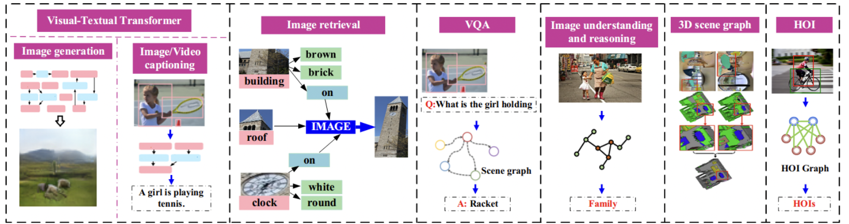
A Comprehensive Survey of Scene Graphs: Generation and Application
Xiaojun Chang, Pengzhen Ren, Pengfei Xu, Zhihui Li, Xiaojiang Chen, and Alex Hauptmann (2022)
A Survey on Graph Neural Networks and Graph Transformers in Computer Vision: A Task-Oriented Perspective
Chen, Chaoqi and Wu, Yushuang and Dai, Qiyuan and Zhou, Hong-Yu and Xu, Mutian and Yang, Sibei and Han, Xiaoguang and Yu, Yizhou (2022)
Notes:
Normally the journal or conf is IEE

Slide 32
I. Armeni, Z.-Y. He, J. Gwak, A. R. Zamir, M. Fischer, J. Malik, and S. Savarese, “3d scene graph: A structure for unified semantics, 3d space, and camera,” in ICCV, 2019.
tried to construct a 3D scene graph of a building. The constructed 3D scene graph consists of four layers: the building, rooms, objects, and cameras. In each layer, there are a set of nodes with their attributes and edges
U.-H. Kim, J.-M. Park, T.-J. Song, and J.-H. Kim, “3-d scene graph: A sparse and semantic representation of physical environments for intelligent agents,” IEEE transactions on cybernetics, pp. 4921– 4933, 2020.
proposed the 3D scene graph to promote the intelligent agents gathering the semantics within the environments, then applying the 3D scene graph to other downstream tasks. Furthermore, the applicability of the 3D scene graph is verified by demonstrating two major applications of VQA (Visual Question and Answering) and task planning, achieving better performance than the traditional 2D scene graph-based methods.
Xiao, Junbin and Zhou, Pan and Chua, Tat-Seng and Yan, Shuicheng, Video Graph Transformer for Video Question Answering, ECCV, 2022
This paper proposes a Video Graph Transformer (VGT) model for Video Quetion Answering (VideoQA). VGT's uniqueness are two-fold: 1) it designs a dynamic graph transformer module which encodes video by explicitly capturing the visual objects, their relations, and dynamics for complex spatio-temporal reasoning; and 2) it exploits disentangled video and text Transformers for relevance comparison between the video and text to perform QA
Notes:
Also mention :
or
One approach for anticipatory action recognition is to use GNNs to model the spatiotemporal dependencies and relationships in the video data. One type of GNN that can be used for this task is the spatiotemporal graph convolutional network (ST-GCN), which can be used to extract features from the video data and classify the actions in the video. The ST-GCN is able to process both spatial and temporal information in the video data and learn the temporal dependencies between the frames.
Another approach is to use graph transformer networks (GTNs), which are a type of transformer-based models that can be used for video understanding. GTNs can be used to extract features from the video data and classify the actions in the video. They can also be used to model the temporal dependencies between the frames in the video data, which allows them to predict future actions.
Additionally, the paper also covers the use of graph attention networks (GATs) for anticipatory action recognition. GATs are a type of GNN that can be used to model the relationships between objects in a video, and how they change over time. This allows them to predict future actions by taking into account the interactions and relationships between objects in the scene.

Slide 33
ridge-Prompt: Towards Ordinal Action Understanding in Instructional Videos Muheng Li , Lei Chen, Yueqi Duan , Zhilan Hu, Jianjiang Feng , Jie Zhou , Jiwen Lu
Video as Conditional Graph Hierarchy for Multi-Granular Question Answering Junbin Xiao, Angela Yao, Zhiyuan Liu, Yicong Li, Wei Ji, Tat-Seng Chua
Ghadi, Y.Y.; Waheed, M.; Gochoo, M.; Alsuhibany, S.A.; Chelloug, S.A.; Jalal, A.; Park, J. A Graph-Based Approach to Recognizing Complex Human Object Interactions in Sequential Data. Appl. Sci. 2022, 12, 5196. (https://www.mdpi.com/2076-3417/12/10/5196)
Semantically Controllable HumanScene Interaction Synthesis Master Thesis Author(s): Zhao, Kaifeng
Notes:
Also mention :
or
One approach for anticipatory action recognition is to use GNNs to model the spatiotemporal dependencies and relationships in the video data. One type of GNN that can be used for this task is the spatiotemporal graph convolutional network (ST-GCN), which can be used to extract features from the video data and classify the actions in the video. The ST-GCN is able to process both spatial and temporal information in the video data and learn the temporal dependencies between the frames.
Another approach is to use graph transformer networks (GTNs), which are a type of transformer-based models that can be used for video understanding. GTNs can be used to extract features from the video data and classify the actions in the video. They can also be used to model the temporal dependencies between the frames in the video data, which allows them to predict future actions.
Additionally, the paper also covers the use of graph attention networks (GATs) for anticipatory action recognition. GATs are a type of GNN that can be used to model the relationships between objects in a video, and how they change over time. This allows them to predict future actions by taking into account the interactions and relationships between objects in the scene.

Slide 34
Clustering of features
Sports Action Recognition Based on Deep Learning and Clustering Extraction Algorithm, Ming Fu,Qun Zhong,and Jixue Dong (2022),Hidawi
Zhang, C., Xu, Y., Xu, Z. et al. Hybrid handcrafted and learned feature framework for human action recognition. Appl Intell 52, 12771–12787 (2022)
Notes:
Recognising human actions in video is a challenging task in real-world. Dense trajectory (DT) offers accurate recording of motions over time that is rich in dynamic information.
To take the advantage of semantical meaningful and “handcrafted” video features through feature engineering, this study integrates the discrete wavelet transform (DWT) technique into the DT model for gaining more descriptive human action features. Through exploring the pre-trained dual-stream CNN-RNN models, learned features can be integrated with the handcrafted ones to satisfy stringent analytical requirements within the spatial-temporal domain. This hybrid feature framework generates efficient Fisher Vectors through a novel Bag of Temporal Features scheme and is capable of encoding video events whilst speeding up action recognition for real-world applications. Ev

Slide 35
Renforcement learning :
A. M. Hafiz, S. A. Parah, and R. A. Bhat,
“Reinforcement learning applied to machine vision: state of the art,”
International Journal of Multimedia Information Retrieval, vol. 10, no. 2, pp. 71–82, May 2021.
Ex:
Agarwal, Rishabh and Machado, Marlos C. and Castro, Pablo Samuel and Bellemare, Marc G.
Contrastive Behavioral Similarity Embeddings for Generalization in Reinforcement Learning
International Conference on Learning Representations (ICLR) 2021
Sonar, Anoopkumar and Pacelli, Vincent and Majumdar, Anirudha
Invariant Policy Optimization: Towards Stronger Generalization in Reinforcement Learning
2020
Notes:
Reinforcement learning (RL) is gaining a foothold in artificial intelligence-based research academia. More and more applications are coming to fore where RL is being applied in a novel and successful manner. As the areas of application are diverse, one important area of industrial and research significance having a high scope is machine vision. In this survey paper, the basics of RL are discussed first in order to give the reader an overview of the technology. Subsequently, the important, novel and upcoming state-of-the-art applications are discussed in the field of RL. The research areas discussed include image segmentation, object detection, object tracking, robotic vision, autonomous driving and image classification/retrieval. Various state-of-the-art works are discussed and an impression of the potential and impact of RL in the field of machine vision is built.
The key idea is to learn a representation that makes the optimal policy built on top of this representation invariant across training domains. Effectively, this approach attempts to learn and exploit the causes of successful actions
A Suvey on Edge Intelligent Video Surveillance with Deep Reinforcement Learning Yan Li
Video violence recognition and localization using a semi-supervised hard attention model Hamid Mohammadi, Ehsan Nazerfard Expert Systems with Applications 212, 118791, 2023

Slide 36
Special note
Thomas Rojat, Raphael Puget, David Filliat, Javier Del Ser, Rodolphe Gelin, and Natalia Dıaz-Rodriguez
Explainable Artificial Intelligence (XAI) on Time Series Data: A Survey
2021
Notes:
Some of the methods presented in this survey are originally applied to other areas than time series. The back-propagation based (Section III-A1) and perturbation-based approaches (Section III-A2) were first designed for the computer vision field and then applied to the time series field. To the best of our knowledge, there is a lack of explainable methods applied on CNNs specifically designed for time series tasks. There must be specificities in time series data that can be exploited to design explainable approaches specific to CNNs that are uniquely adapted to the time series field
Most methods presented in this survey indicate which specific regions of the input data get attention from the model while classification is performed. They do not provide any confidence in the model, neither mitigates its vulnerabilities. However, it can be one way to provide some explanations and increase the trust in the system. Indeed, a user or a developer can rely more on the system if he knows that the model gives its attention to the relevant parts of the input for a specific prediction. However, the trust brought by these methods can be questioned by the unintuitive aspect of time series. For instance, saliency maps on images are directly interpretable as we usually understand the content. It is different for time series because expert knowledge might be needed to understand its outcomes. Some data mining methods might be useful to automatically extract the underlying content of time series. As highlighted in this survey, it is possible to use the insights provided by some explainable methods to increase the epistemic confidence in the model. Obviously, the purpose of XAI is to get some information and understanding of the model, and therefore to provide trust. However, the XAI field has more potential than just facilitating trustworthiness. Explainability has the potential to lead to new metrics and training practices ensuring the confidence and robustness of the most complex and abstract models, thanks to the insights explainable methods can provide. We are also far from getting an end-to-end XAI system, as methods only focus on the technical parts. XAI techniques do not consider interactions with the user or developer that are necessary for the AI system to be trusted and used. There is a lack of objective tools to demonstrate the robustness of AI systems. This is why interactive systems providing explanations and feedback might be a leading way to empirically and subjectively show the user and decision maker that the AI system can be trusted.

Slide 37
References
World Health Organization. World report on violence and health. 2002.
Wanli Ouyang Wenhao Wu, Zhun Sun. Transferring textual knowledge for visual recognition. arXiv, 2022.
Wenhao Wu, Dongliang He, Tianwei Lin, Fu Li, Chuang Gan, Errui Ding, MVFNet: Multi-View Fusion Network for Efficient Video Recognition, arxiv, 2021
Notes:
anticipatory action recognition

Slide 38
Thank you for listenning !

